Slide 1
PHYS60022 Data Science and Machine Learning for Physics
Week 3: Likelihoods
Spring 2025

Slide 2
Hypothesis Testing (recap)
Last week, we discussed the concept of Hypothesis testing
We introduced the null (H₀) and alternate (H₁) hypotheses and how we can use the data to test compatibility of a hypothesis with experimentation
We introduced two key quantities needed to construct a hypothesis test
The Type-1 error rate
The power
?
H₁
H₀
Data

Slide 3
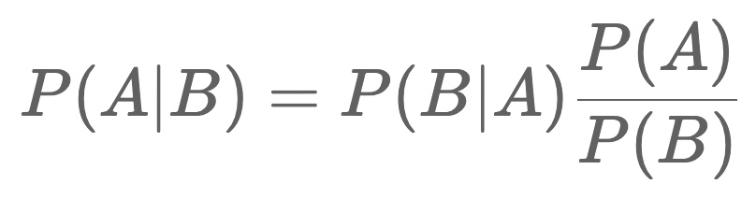
Likelihoods
We need to introduce an important concept in statistics → the Likelihood
Remember from Week 1, we derived Bayes’ theorem for two events A and B

Slide 4
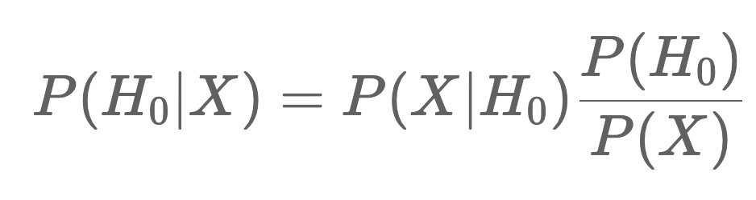
Likelihoods
We need to introduce an important concept in statistics → the Likelihood
What if we replace B with the outcome of some random variable X, and A with a specific Hypothesis - eg H₀?

Slide 5
Likelihoods
We need to introduce an important concept in statistics → the Likelihood
What if we replace B with the outcome of some random variable X, and A with a specific Hypothesis - eg H₀?
Let's take a look at the terms now.
P(H₀) is known as the prior probability of the null hypothesis and represents a probability that we would associate to the hypothesis before seeing any data
P(H₀|X) is known as the posterior probability, ie the probability we assign to the hypothesis after we have made the measurement or observed the random value for X.

Slide 6
Likelihoods
We need to introduce an important concept in statistics → the Likelihood
What if we replace B with the outcome of some random variable X, and A with a specific Hypothesis - eg H₀?
Let's take a look at the terms now.
P(H₀) is known as the prior probability of the null hypothesis and represents a probability that we would associate to the hypothesis before seeing any data
P(H₀|X) is known as the posterior probability, ie the probability we assign to the hypothesis after we have made the measurement or observed the random value for X.
P(X|H₀) is known as the likelihood of the measurement X under the hypothesis H₀.
/

Slide 7
Likelihoods
We need to introduce an important concept in statistics → the Likelihood
What if we replace B with the outcome of some random variable X, and A with a specific Hypothesis - eg H₀?
Let's take a look at the terms now.
P(H₀) is known as the prior probability of the null hypothesis and represents a probability that we would associate to the hypothesis before seeing any data
P(H₀|X) is known as the posterior probability, ie the probability we assign to the hypothesis after we have made the measurement or observed the random value for X.
P(X|H₀) is known as the likelihood of the measurement X under the hypothesis H₀.
/

Slide 8
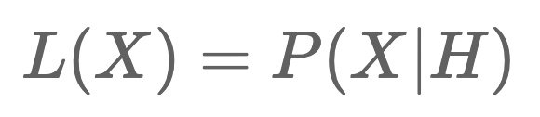
Likelihoods
For a single random variable X, it is easy to calculate the likelihood for a specific hypothesis H given the definition, i.e
"the value of the likelihood for the hypothesis H is the conditional probability of X given H".

Slide 9
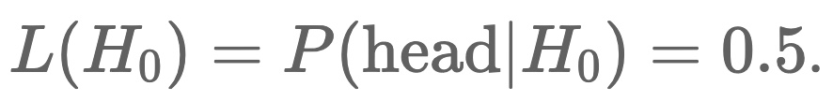

Likelihoods
For a single random variable X, it is easy to calculate the likelihood for a specific hypothesis H given the definition, i.e
"the value of the likelihood for the hypothesis H is the conditional probability of X given H".
Example, if X is tossing a "head" on a coin and we choose a null hypothesis H₀ as the hypothesis that the coin is fair, then

Slide 10
Likelihoods
For a single random variable X, it is easy to calculate the likelihood for a specific hypothesis H given the definition, i.e
"the value of the likelihood for the hypothesis H is the conditional probability of X given H".
Example, if X is tossing a "head" on a coin and we choose a null hypothesis H₀ as the hypothesis that the coin is fair, then
Suppose we make repeated trials of the random variable X. We can still calculate the likelihood since we know how to calculate the probability for independent random variables - it's just the product of the individual probabilities.
Let's say we toss the coin five times in a row and get the sequence (h,t,t,h,t) (h= head, t= tail), then the likelihood for H₀ is

Slide 11
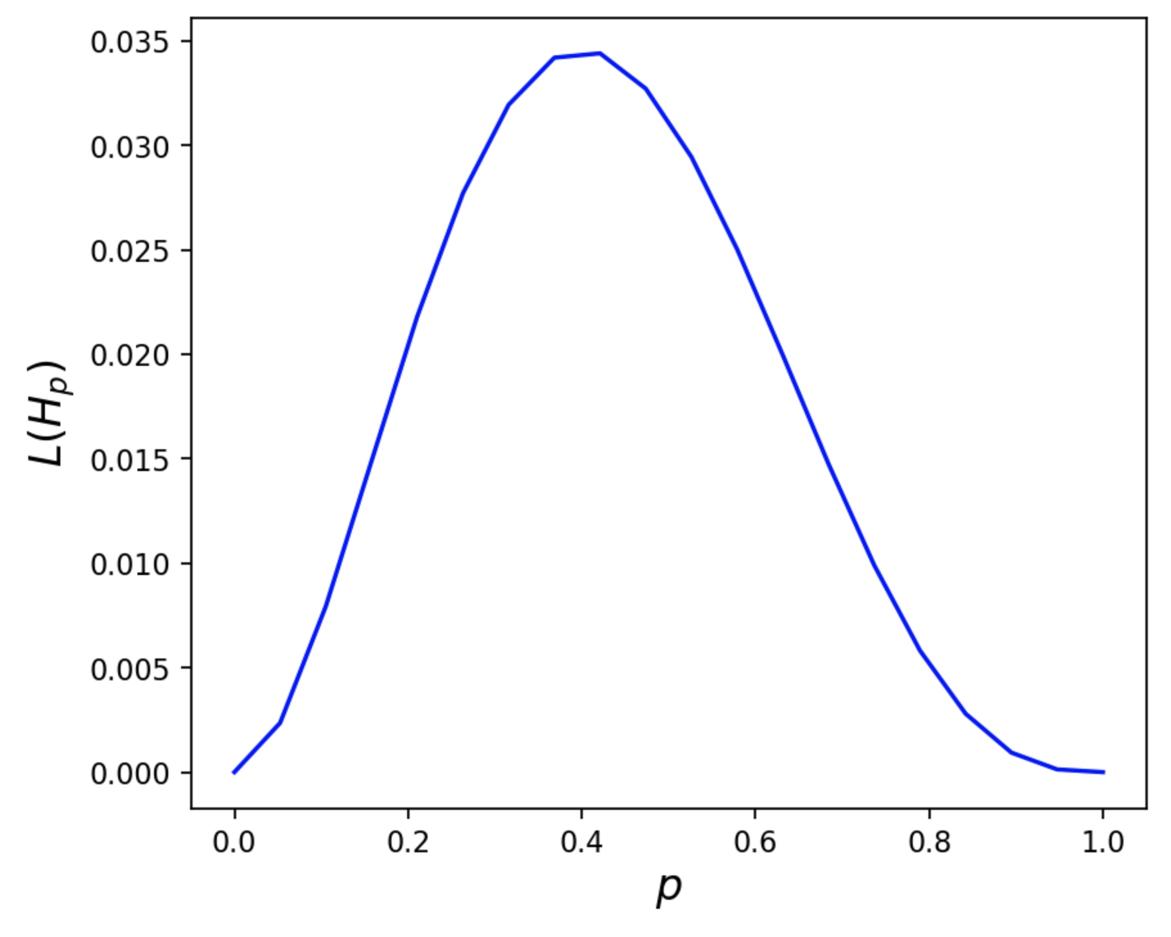
Likelihoods
What if we hypothesised that the coin was unfair with P(h)=0.6 and P(t)=0.4 - let's call this hypothesis H₁. The likelihood is now,
We can see that the likelihood for H₀ is larger than for H₁ . This comparison of likelihoods is a key concept in hypothesis testing. In fact, the likelihood alone is not what we will use, but rather the ratio of likelihoods that will be important.
Extending this idea to L(H_{p}) where p= probability for heads
This function is smooth even though we have a discrete random variable (more in Week 4 on this)

Slide 12
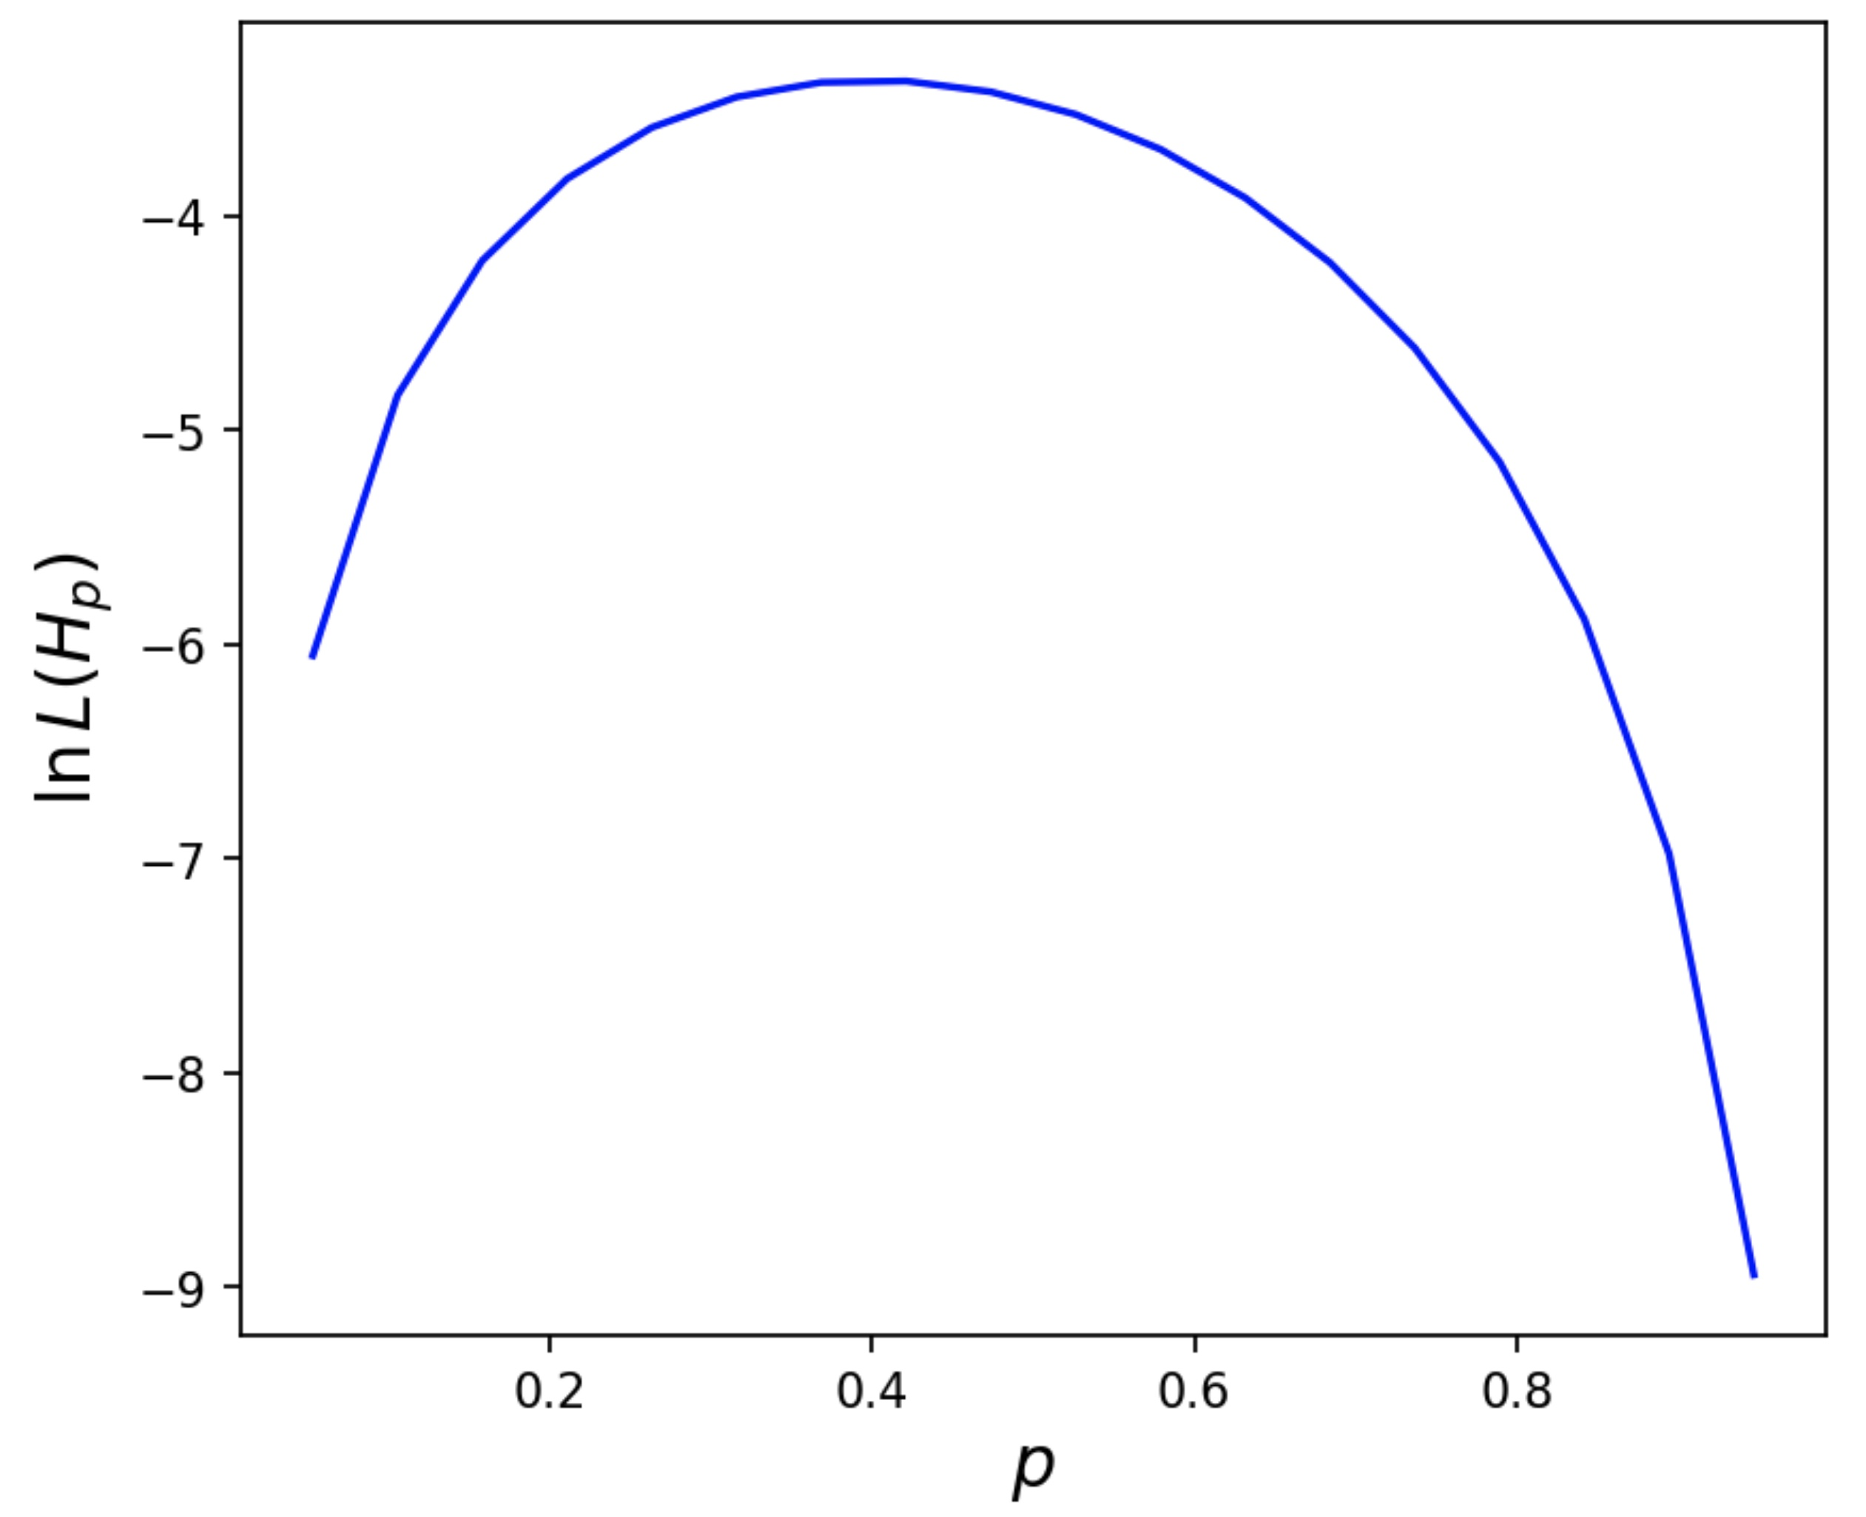


Log-likelihoods
We can also see from this example that likelihood values tend to be extremely small given we end up taking products over probability densities. It is much easier to work with the log of the likelihood so we typically do that instead.
In scipy, we can use the functions for discrete random variables and for continuous random variables

Slide 13
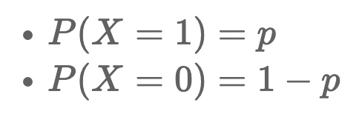
Example: Binary log-likelihood
Consider a binary random process, eg
a sequence of heads or tails for a coin toss
a sequence of cats and dogs in a random set of pet photographs.
a random sequence of binary digits (0,1,1,0,0,0,1,...)
Each outcome follows a Bernoulli distribution, if we assign one outcome as "success" and the other as a "failure".
Let's assume the probability for success (head, cat, 1, etc) is p and the probability for failure (tail, dog, 0, etc) is therefore (1-p) - ie this is our hypothesis H_{p}

Slide 14
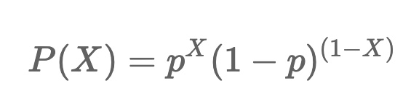
Example: Binary log-likelihood
This probability can be concisely written as,

Slide 15
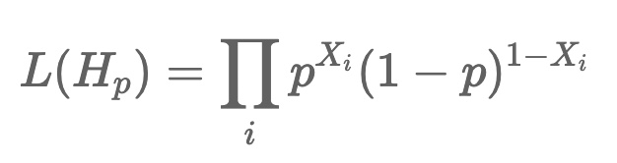
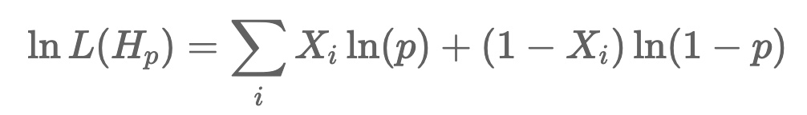
Example: Binary log-likelihood
This probability can be concisely written as,
The likelihood for our sequence of events can now be written as,
And so taking the log
In ML, this is known as the “Binary Cross-Entropy” loss

Slide 16
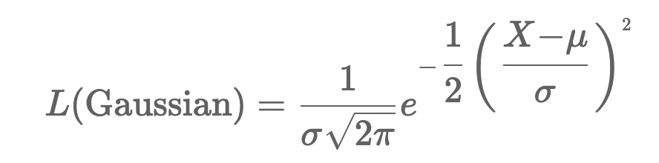
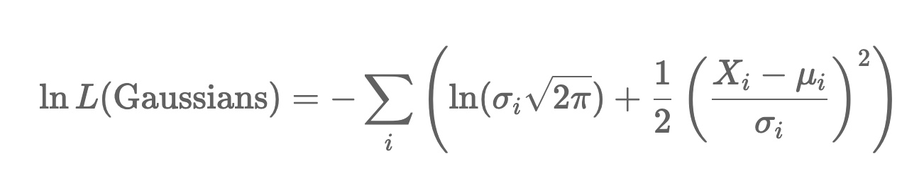
Example: Gaussian likelihood
Suppose we have a random variable X that is distributed according to a Gaussian distribution with mean μ and standard deviation σ
The likelihood for a measured value of X will be
For a set of independent random variables X_{i} each distributed as a Gaussian with mean μ_{i} and standard deviation σ_{i} we have

Slide 17
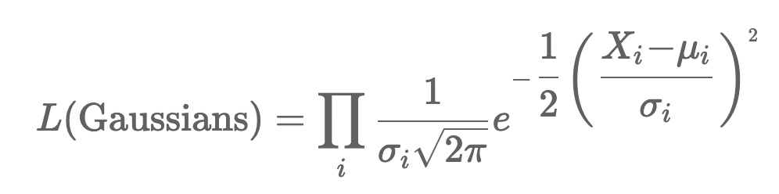
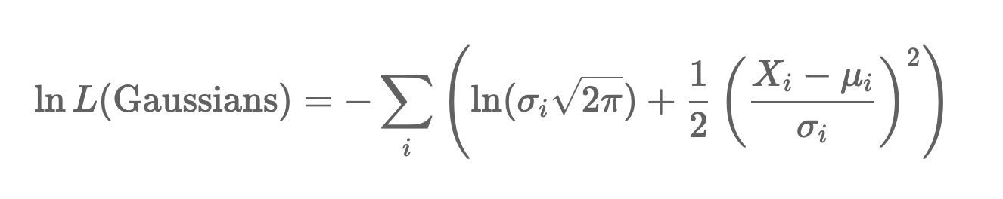
Example: Gaussian likelihood
For a set of independent random variables X_{i} each distributed as a Gaussian with mean μ_{i} and standard deviation σ_{i} we have
Taking the log, we find
This term should be familiar to you …

Slide 18
Binned Likelihoods
For large datasets, it is often computationally more efficient to use Binned likelihoods
Each bin (i) can be considered as a Poisson random variable

Slide 19
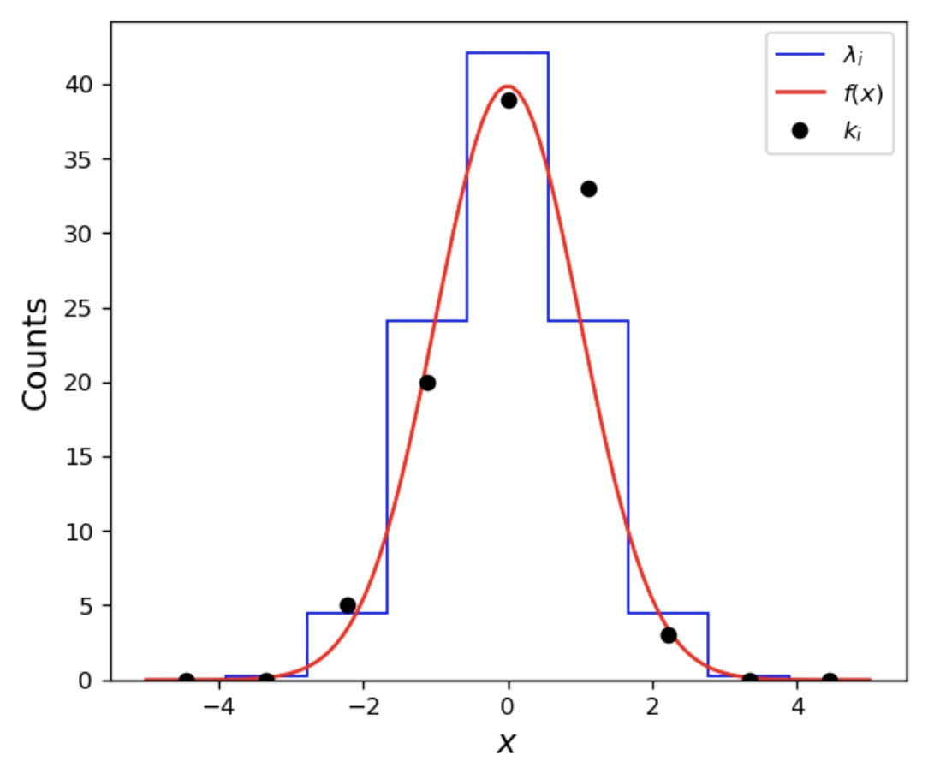
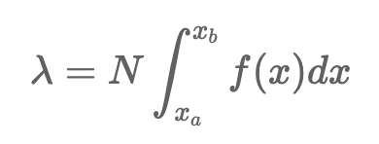
Binned Likelihoods
For large datasets, it is often computationally more efficient to use Binned likelihoods
Each bin (i) can be considered as a Poisson random variable
where [x_{a}, x_{b}] defines
the bin-boundaries
k = the number of events landing in the bin

Slide 20

Binned Likelihoods
For large datasets, it is often computationally more efficient to use Binned likelihoods
Each bin (i) can be considered as a Poisson random variable
where [x_{a}, x_{b}] defines
the bin-boundaries
k = the number of events landing in the bin
Note that
→ In scipy for example …

Slide 21
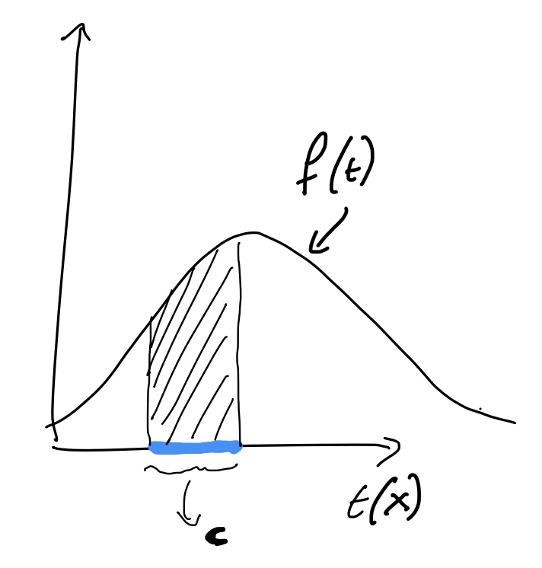
Likelihood Ratios
Returning to our topic of hypothesis testing, how can we use the likelihood?
Remember that we defined the Type-I error and power as
Where “c” is the critical region

Slide 22
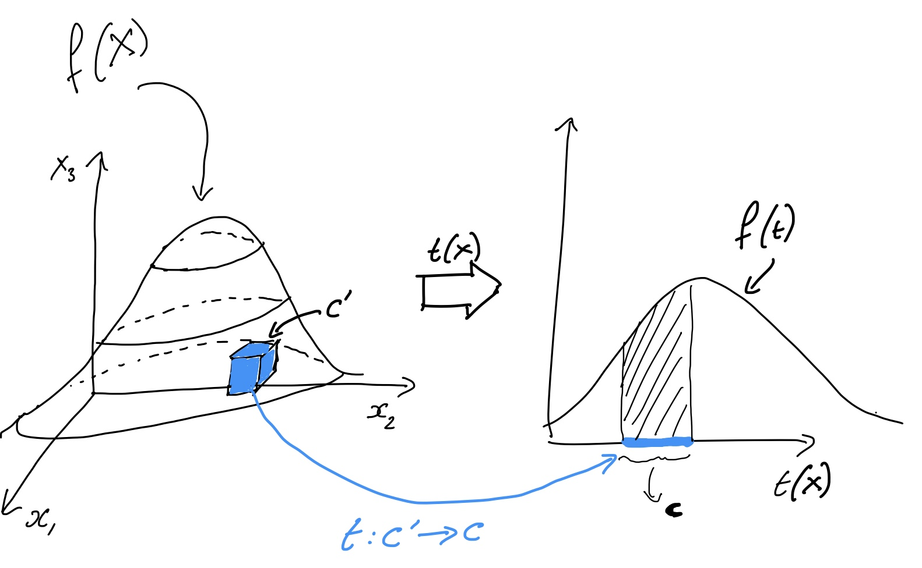
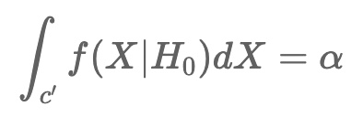
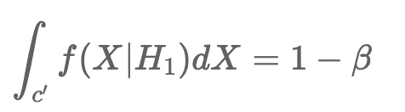
Likelihood Ratios
Returning to our topic of hypothesis testing, how can we use the likelihood?
Remember that we defined the Type-I error and power as
Where “c” is the critical region
There must be an equivalent region c’ in our
observable (X) space so that
and

Slide 23
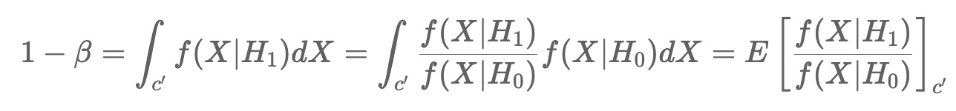
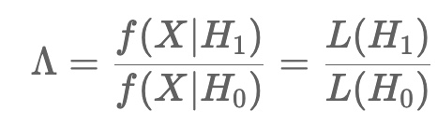
Likelihood Ratios
We can re-write the expression for the power as,
The last quantity looks like an expectation value of a quantity
This is the likelihood ratio
We should choose the critical region so that this ratio is maximized
→ equivalent to using some function of Λ as the test-statistic

Slide 24
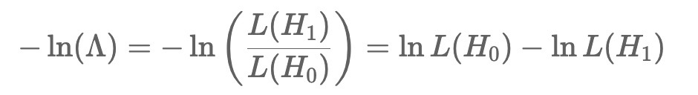
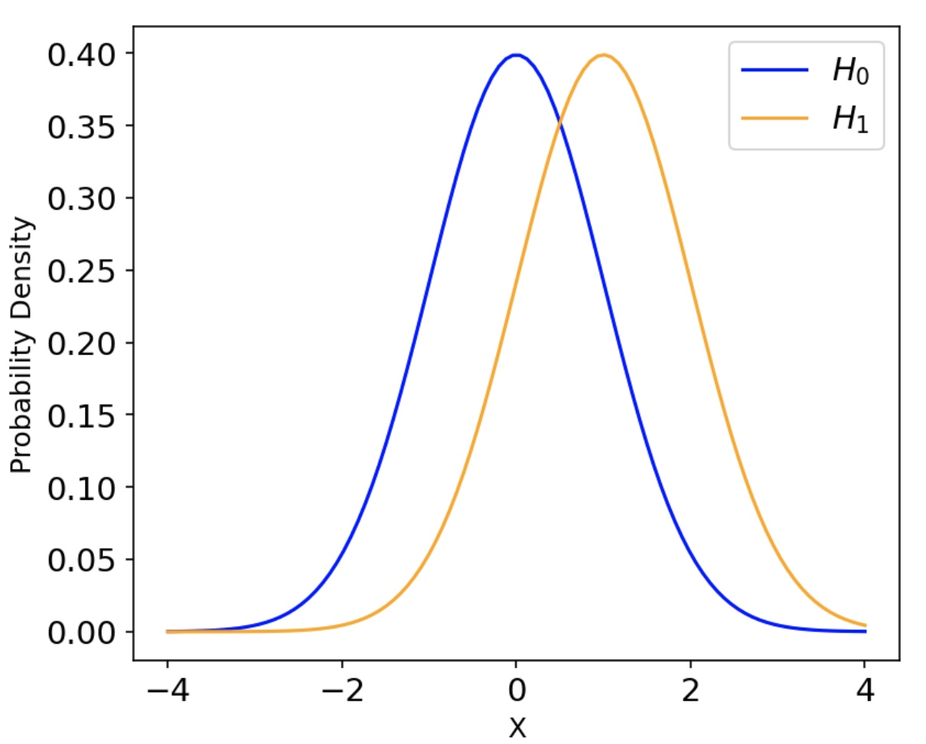
Likelihood Ratios
We tend to use the negative log-likelihood ratio
We choose the critical region to include as many small values of the negative log-likelihood ratio as possible. This result is known as the Neyman-Pearson lemma. It effectively says that the most powerful test-statistic is to use the negative log-likelihood ratio and choose negative values as the critical region.
Example:
Let’s take a look again at
our Gaussian example

Slide 25
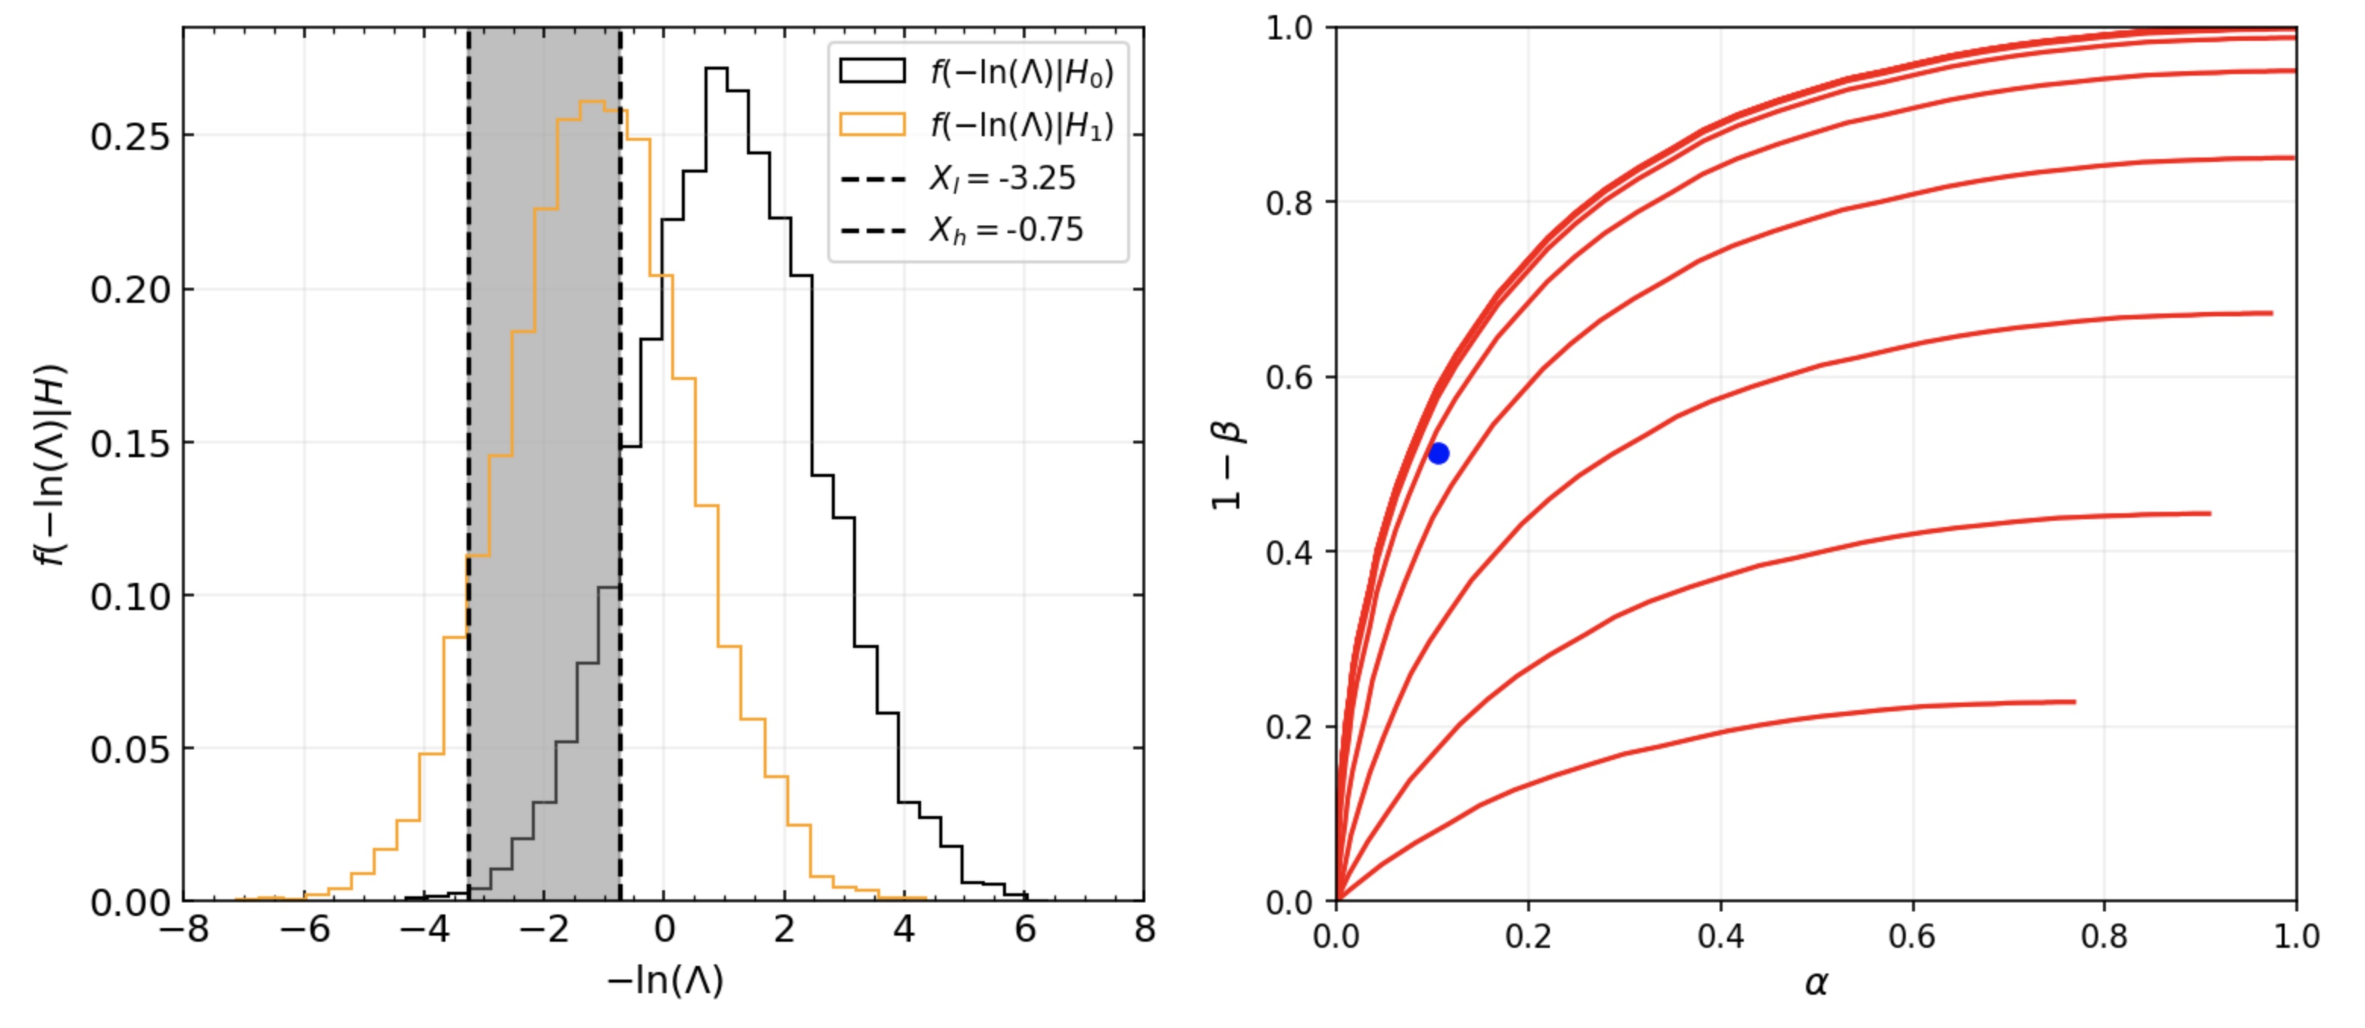
Gaussian Example
The curve of Type-I error vs Power indicates that the best performance is indeed formed when the lower bound of the critical region is as far left on the x-axis as possible!
X_{l} =-8
X_{l} =0
Try this for yourself in today’s notebook

Slide 26
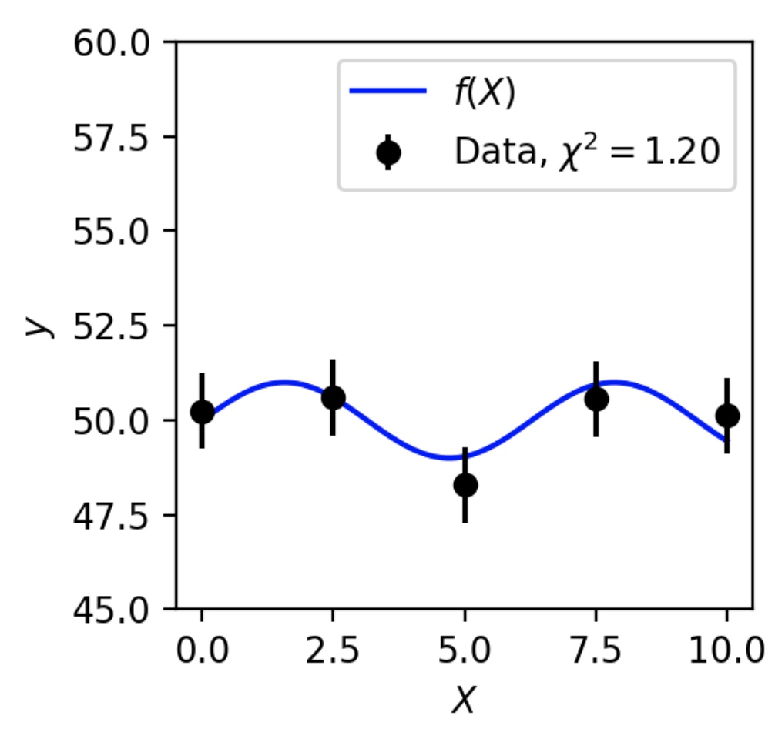
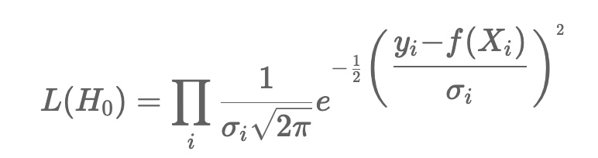
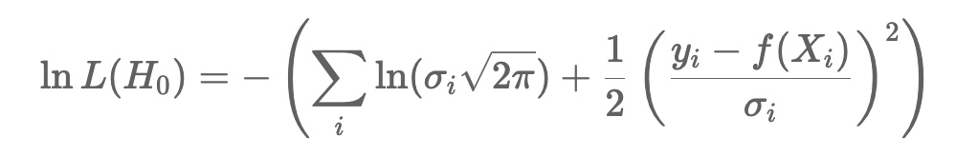
Deriving the χ² test-statistic
Let’s return to the scenario seen last lecture
We want to test the compatibility of a function f(X) with our data points
Assume that y_{i} follows a Gaussian distribution with mean = f(X_{i}), standard deviation = σ_{i}
All data points are statistically independent

Slide 27
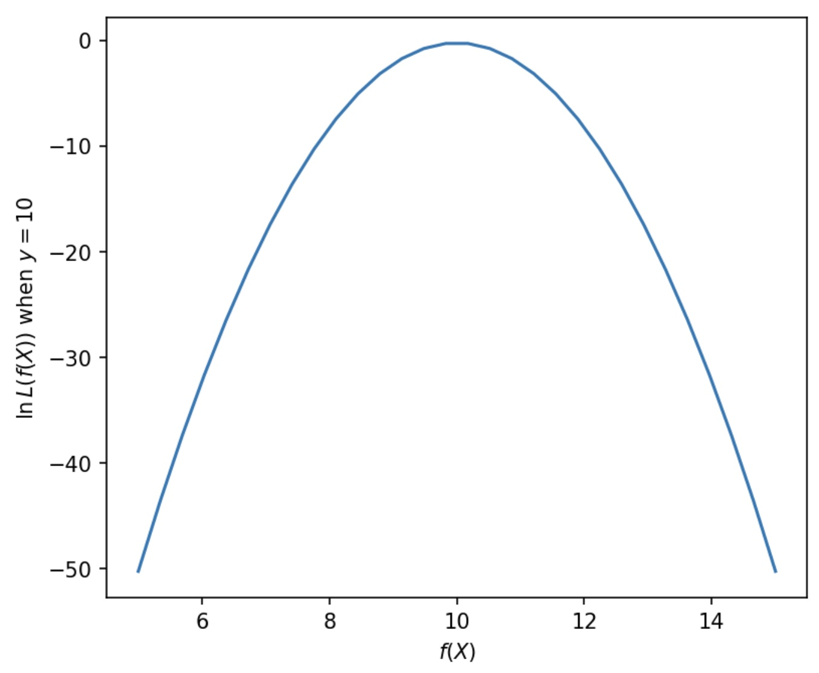
Deriving the χ² test-statistic
To complete the likelihood ratio we also need a H₁.
We can ask the question, which values of f(X_{i}) would give us the largest values of the likelihood function (or equivalently the largest log likelihood function)?
Let's take a look at the log likelihood function for a single Gaussian measurement y=10 with σ=0.5 as a function of f(X).
The maximum (“most likely”) is found for f(X)=y=10 → use this as H₁
We will learn more about this concept next week

Slide 28
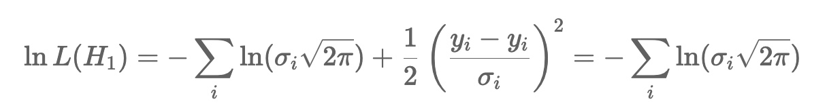
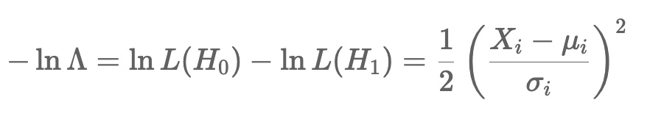
Deriving the χ² test-statistic
This is the same as the χ² test-statistic that we saw last week, except for the factor of ½ !
It is common in fact to use -2 ln Λ to make these two identical

Slide 29
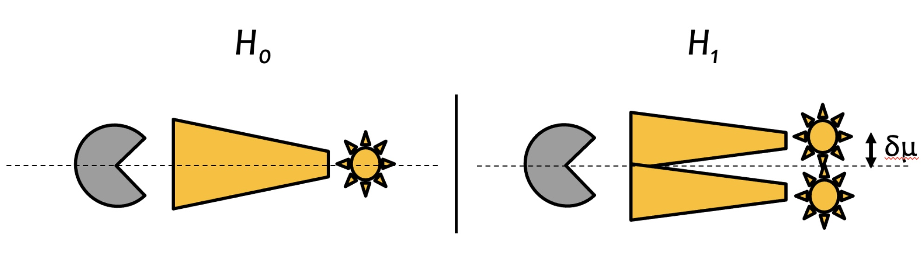
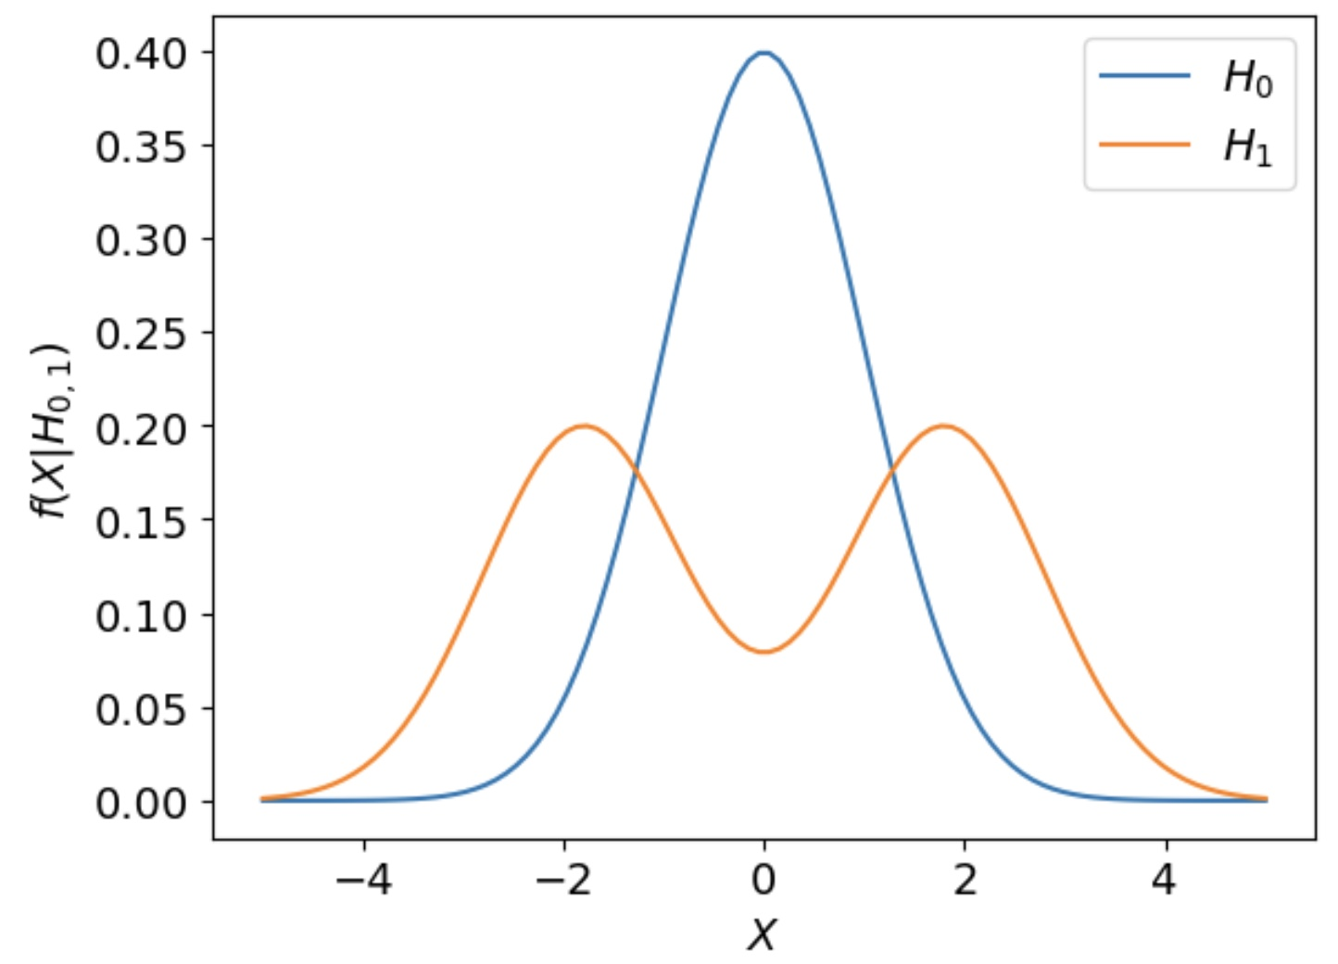
Likelihood ratios as classifiers
The Neyman-Pearson lemma is a very important result in Machine Learning for classification
→ It tells us that the most powerful classifier will always be the likelihood ratio
→ All of the Machine Learning classifiers that you will see later in this course are approximations of this likelihood ratio (or rather functions of it)!
This week’s exercises are about calculating likelihoods using python and using likelihood ratios in classification problems

